Slide 1

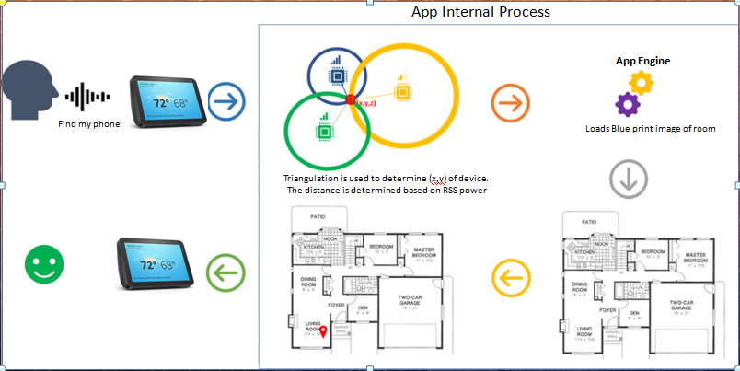

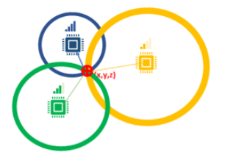





InLoVE: Indoor Localization Using Voice Enabled Systems
Corey Doss, Pavan Kumar Kota, Sravan kumar Pagadala, Sindhusha Tiyyagura
Advisor: Dr. Sejun Song, University of Missouri – Kansas City
MOTIVATION:
In recent years we have seen increased interest in positioning systems. The positioning system can be defined as a mechanism for determining the exact location of the object/person. We rely heavily on Global navigation satellite systems such as GPS( Global Positioning system) for outdoors but GPS is not an option to locate device or people indoors.
So, our main motivation is to implement a system which can accurately locate and track the device inside the buildings.
MOTIVATION:
CURRENT PROBLEMS WITH GPS
WORKING OF InLoVE
Received signals are extremely weak ( a quadrillionth of a Watt)
Affected by buildings, space weather, radio interference.
GPS Jammers are cheaply available in the internet.
Cannot guide people inside shopping malls, museum tours, warehouses, airport, hospitals, hotels
We have used one ESP32 as a transmitter/device which acts as an access point .
We have used four ESP32 devices , were coded in arduino programming which acts like receivers/scanners. The scanners were connected to the local home Wi-fi and then gets the RSSI signal power for the device.
Each scanner also acts like a web server, where the RSSI value is populated in the web URL.
In an Android application, when a user requests for “Find my phone”, we are doing http request of the web URL which internally requests the scanners to get the distance in meters (converted RSSI power dBm value).
The android application collects all 4 distances from 4 different scanners and does triangulation to get the exact position of the device.
After finding the position android app routes to a new page where the device location is shown as an icon on the blueprint image of the room .
OUR SOLUTION: InLoVE
Using RSSI(Received Signal Strength Indicator) and Triangulation for tracking the devices indoor.
Using signal strengths, gives accurate and precise distances.
It is of low cost, does not require extra hardware requirements.
Main advantage of RSSI is, it does not have line of state channel compared to other approaches.
RSSI (RECEIVED SIGNAL STRENGTH INDICATOR)
RSSI is a measurement of power level(in terms of dBm) received by the sensor.
The distance(in terms of meters) is estimated from the received power using the below formulae: where d0 = 8.838m, prd0 = -56.98dBm
RSSI between transmitter and receiver:
Transmitter
RSSI
Receiver
RSSI TRIANGULATION
Triangulation is the process of determining the location/position of the object from the known distances.
Using RSSI we get the distance of object, but not the exact direction of the object. So we use triangulation to get the exact location of the object. This is valid when we have at least 3 receivers.
CONCLUSION
Successfully, we are able to show the accurate position of the device in indoors.
Future work includes more thorough path loss to ensure accurate position of the device inside the buildings.
We find the (x,y) coordinates of an object by using distances given by the receivers.
Source Code
Project Demo

